Slide 1
Project Helper
Authors: Zachary Freeman, Aide Cuevas, Donavan Drouin

Slide 2
Purpose of the System
The “Why?”
One of the biggest challenges I face as a Computer Science student is coming up with a good idea for a project.
Hence, I created ProjectHelper. The purpose of this system is to generate a 'README.md' file that provides a general guideline to help students better understand what to do for their projects. This includes an original idea, technologies needed.
It also submits the 'README.md' to your GitHub by creating a repository when you provide your developer token.

Slide 3
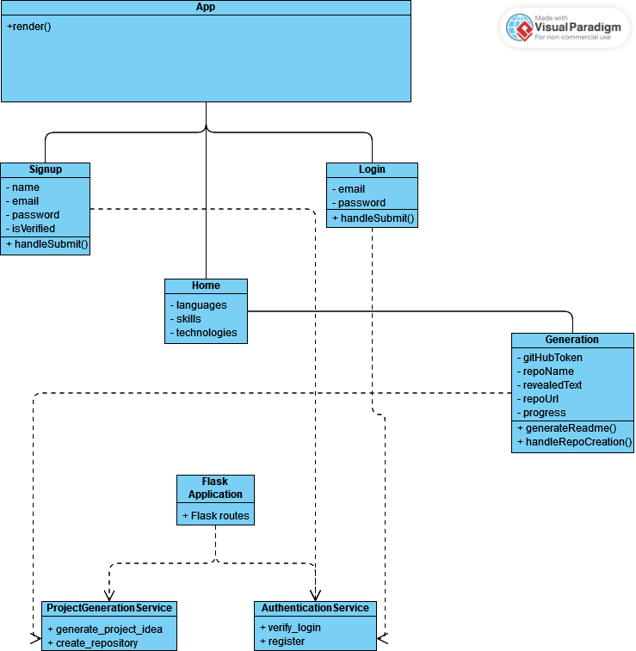
Our Class Diagram

Slide 4
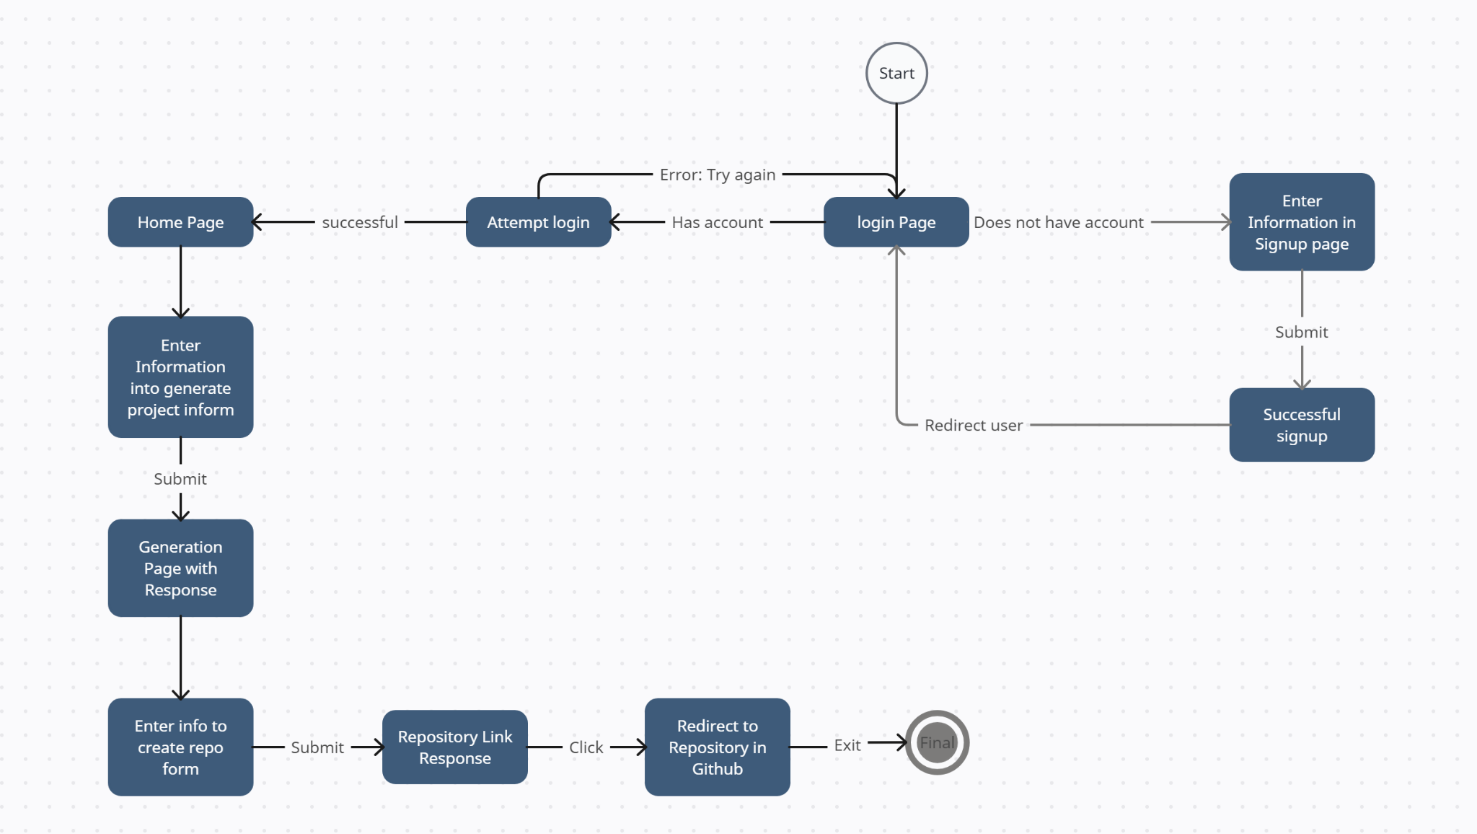
System State Chart

Slide 5
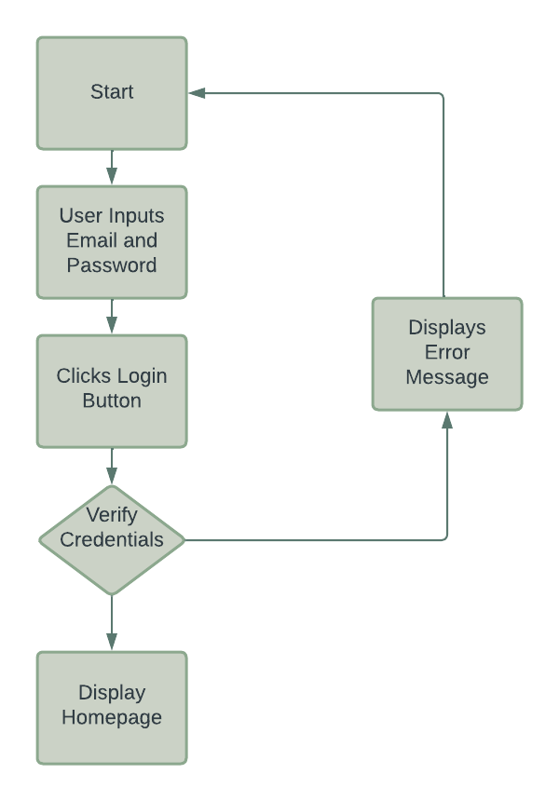
Acceptance Test Cases
AUTHENTICATION TEST CASE:

Slide 6
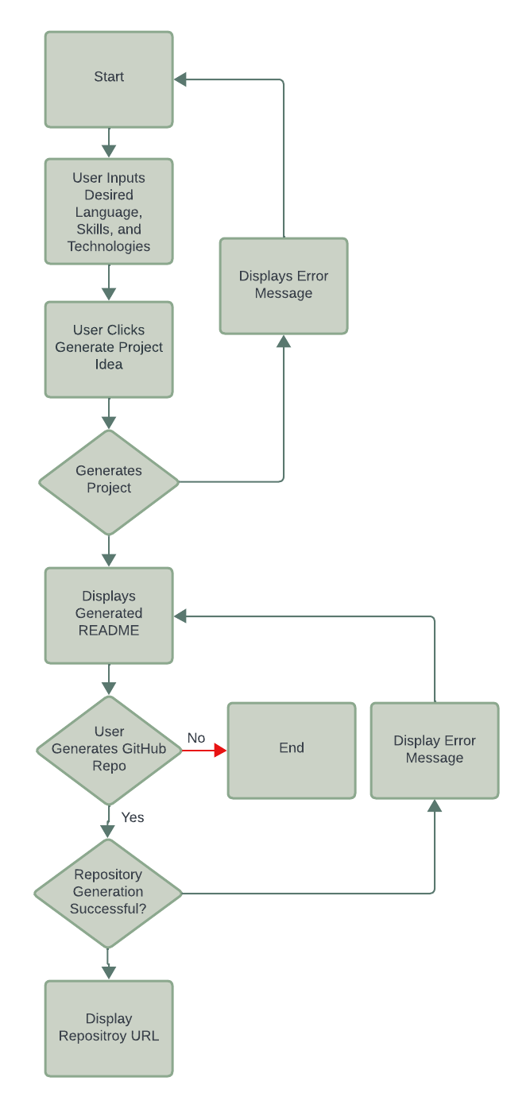
Acceptance Test Cases
PROJECT GENERATION SERVICE TEST CASE:

Slide 7
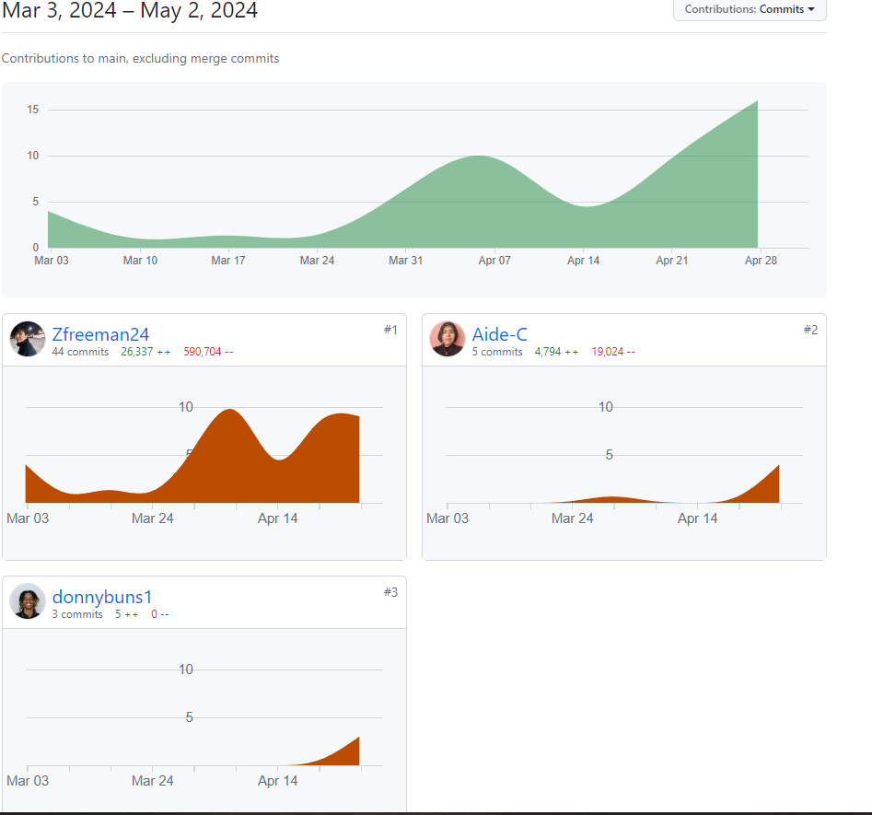
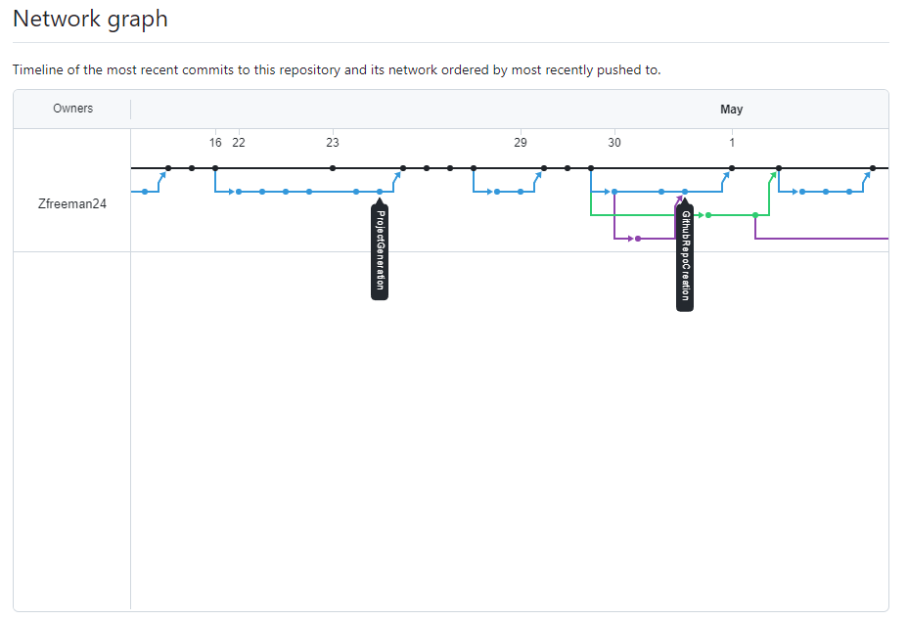
Our Github Network
As of: 5/2/2024 @ 3:28PM

